Slide 1

JQuery Ajax
Authored by : Pushkar Kulkarni Presented by : Yogesh Gaikwad

Slide 2
Agenda
Events
Jquery - Ajax

Slide 3
Events
Provides a unified method for establishing event handlers and event cancelling
Standard event-type names are used
“click” or “mouseover”
Multiple Event handlers allowed
Event instance is available as a parameter to the handlers
jQuery's event system normalizes the event object

Slide 4
Events
.blur()
.change()
.click()
.dblclick()
.focus()
.hover()
.keydown()
.keyup()
.keypress()

Slide 5
jQuery.Event
The event object is guaranteed to be passed to the event handler
Attributes
Type, target, data,
Methods
.preventDefault(), .stopPropogation()

Slide 6
Events
.bind(), .live(), on()
.unbind(), die(), off()
.delegate()

Slide 7
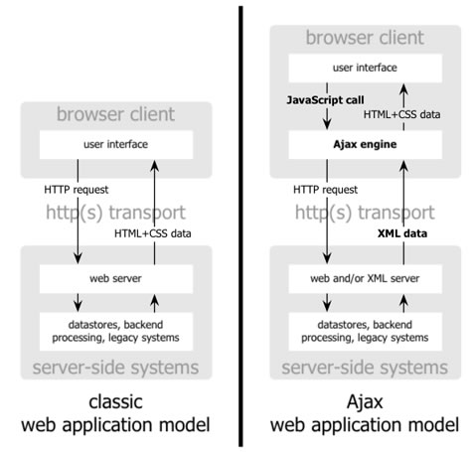
AJAX

Slide 8
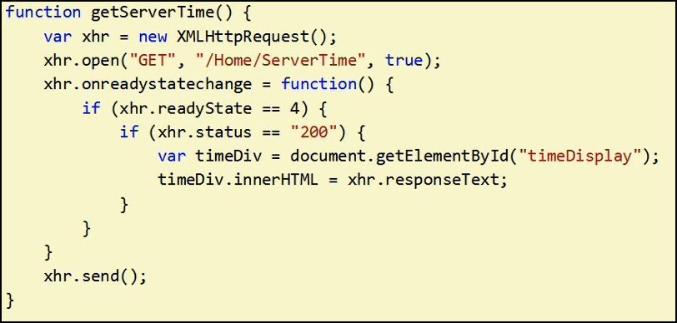
Raw Ajax
XMLHttpRequest
Sample Ajax implementation

Slide 9
JQuery: Ajax
Simple API or Helper methods
Allows partial data to be posted as well as updated
Supports both GET and POST
PUT and DELETE
Supports any data like XML, HTML, JSON and even JavaScript
Works with web service, Rest API and more
Supports all browsers

Slide 10
JQuery: Ajax Functions
$(selector).load
to load HTML data from server
$.get() and $.post()
to handle raw data
$.getJSON():Get/Post
to get JSON data
$.ajax()
the base function with all possible options

Slide 11
JQuery: Ajax Events
Local Events
Specific to that Ajax request
Success, error, complete, beforeSend
Global Events
These events are broadcast to all elements in the DOM
ajaxStart, ajaxSend, ajaxSuccess, ajaxError, ajaxComplete
Global events can be disabled, for a particular Ajax request
$.ajax({ url: "test.html", global: false, // ... });
ajaxSetup
Global setting for all Ajax request
The options provided here can be overwritten in local events

Slide 12
Any Questions?

Slide 13
ThankYou!

